Slide 1
SPA/SPAC Updates 2nd Quarter 2017
May 25, 2017
2:30 – 4:00 pm

Slide 2
SPA Personnel
Emmanuel Shodeinde, Senior Administrator
Contract team white
Adrianna Dunnock, Analyst
Contract team red
One open position for Administrator, SPA
Positing soon!

Slide 3
SPA Teams
Team Red—Proposals
Managed by Greg Sorensen
Processes all proposals
Marie Coolahan (lead)
Towanda Gilliam
Suzanne Hollis
Team White—Proposals
Managed by Greg Sorensen
Processes all proposals
Debbie Griffith (lead)
Christine Toalepai
Mike Starace

Slide 4
SPA Teams
Team Red—Contracts
Managed by Stephen Peterson
Processes all contracts
Stacey Boyd (lead)
Process all subawards
Venzula Harris
Adrianna Dunnock
Team White—Contracts
Managed by Stephen Peterson
Processes all contracts
Emmanuel Shodeinde (lead)
Process all subawards
William (Bill) Hugo

Slide 5
SPA Teams
Contact your SPA team red or white for any questions unless you have been triaged to a specific person in SPA.
Use the SPA team email addresses
Team-white@ordmail.umaryland.edu
Team-red@ordmail.umaryland.edu

Slide 6
Submission Updates
Grants.gov Workspace
Legacy Application Package (Adobe) phased out 12/31/2017.
Applicants will no longer be able to download the older, single PDF application package of forms.
The new online forms interface is now available in Grants.gov (as of February 2017) and is only accessible through Workspace.
For any funding opportunities where applicants have downloaded the legacy PDF application package, they will be able to continue to submit that package until March 31, 2018.

Slide 7
Submission Updates
The use of ASSIST, Adobe (while available), or Workspace must be approved by Dennis Paffrath.
At this time ALL applications that can be processed via KC should be submitted via KC.

Slide 8
Kuali Update
SPA needs department representation to assist with the Kuali testing
SPA is working on the training for the campus
No “official” Go Live date for the new instance

Slide 9
Federal Demonstration Partnership FDP Clearing House
Reduce administrative burden in creating subs
UMB is a part of a pilot with FDP
Any school participating in this pilot will receive the one page subrecipient commitment form; or they can provide the FDP abbreviated template.
The organization tab in KC will identify which schools are participating in this pilot.
If FDP Address is Yes, 1 page form
IF FDP Address is blank, 3 page form

Slide 10
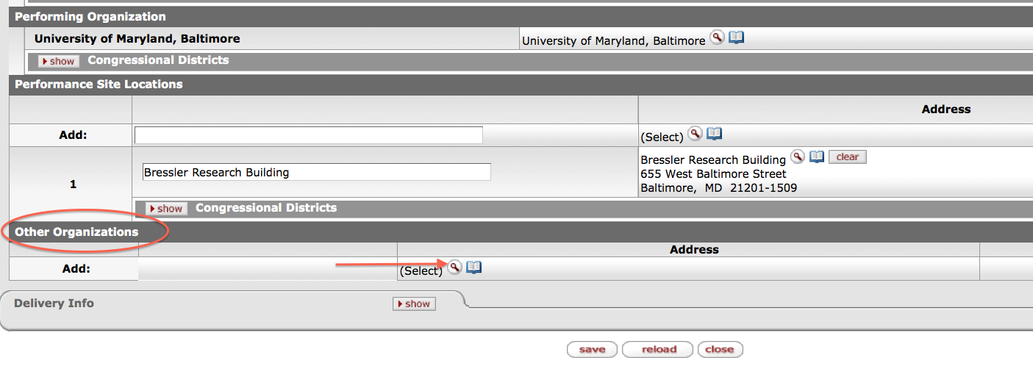

Slide 11
Reminders
Please, please use the team emails when communicating with SPA, unless an action has been triaged and you know who the SPA person that is working on that action.
You must use the Subrecipient Commitment Form if you have a subrecipient within your proposal. SPA staff have been instructions to hold your proposal until the form is in KC. FDP schools are the only exception!
If you change the deadline date, please update your team or the person working on your proposal immediately!

Slide 12
Reminders
Please give SPA adequate time to review your proposal.
Update your routing approval maps in KC!
SPA will only bypass on the deadline day.
Getting your Proposals in early
And remember… Research Matters!

Slide 13
Questions?

