Slide 1
SPA/SPAC Updates
4th Quarter 2014
November 20, 2014
2:30 – 4:00 pm
Pharmacy Hall Auditorium

Slide 2
Today’s Agenda
SPAC Personnel Changes
Federal Closeouts under the new by-award draws
30+ hour CI and CII fringe benefit rates
Direct Retro Search Capability
NCURA professional development opportunities
Payroll Processing Timelines
Deposit Procedures for Payments received by the department
Columbia $9M settlement
Status of Uniform Guidance Implementation
SPA Personnel Changes
Kuali Coeus Issues

Slide 3
New/Changed Staff
Assistant Director, Amy LaFevers
Michelle Moore Team Yellow
Hiring a Manager for Team Red
Hiring for a new “floater” position

Slide 4
SPAC ORGANIZATION CHART
Effective 11/1/2014
Team White, Fritz Alphonse, Manager
Wendy Yu, Financial Accountant
Dan Grote, Financial Accountant
Christine Elliot, Financial Accountant
Team Red Vacant, Manager
Krista Salsberg, Financial Accountant
Team Yellow, Beryl Gwan, Manager
Shernett Wynter, Financial Accountant
Laura Scarantino, Director
Central and Collections Kathleen Wiess, Manager
Karen Little, Accounting Analyst
Brenda Hester, Accountant
Cheryl Williams-Smith, Financial/Closeout Accountant
Collections, Mary Miller, Accountant
Kerrisha Riggs, Financial Accountant
Ron Hill, Financial Accountant
Tina Zhu, Financial Accountant
Michelle Moore Financial Accountant
Amy Lafevers, Assistant Director
Vacant, Financial Accountant Floater

Slide 5

90 days Use it or Lose It

Slide 6
A110 Subpart D section 71
Uniform Guidance: § 200.343 Closeout
(a) The non-Federal entity must submit, no later than 90 calendar days after the end date of the period of performance, all financial, performance, and other reports as required by or the terms and conditions of the Federal award. The Federal awarding agency or pass-through entity may approve extensions when requested by the non-Federal entity.
(b) Unless the Federal awarding agency or pass-through entity authorizes an extension, a non-Federal entity must liquidate all obligations incurred under the Federal award not later than 90 calendar days after the end date of the period of performance as specified in the terms and conditions of the Federal award.
Notes:
NSF: Failure to submit timely reports will delay NSF review and processing of pending proposals and processing of additional funding and administrative actions, including, but not limited to, no cost extensions for all identified PIs and co-PIs on a given award. In the case of continuing grants, failure to submit timely reports may delay processing of funding increments

Slide 7
90 Calendar Closeout
Grantees must liquidate all obligations incurred under their awards not later than 90 calendar days after the award end date
This has always been the rule – no longer an option

Slide 8
Extensions
Unless the Federal awarding agency or pass-through entity authorizes an extension
30 or more days prior to the award end date

Slide 9
By Award Account (P)
Federal Agency can already see by award spending on this account
Not waiting until 12/26/2014
5-10 awards expiring per month starting September 2014

Slide 10
Failure to Comply
All valid charges are not posted to the award
Dept. does not obtain an extension
Dept. will lose use of funds
Dept. will need to fund the deficit
Could affect future funding

Slide 11
Departments Taking Action
Monitoring Expenses Closely
Ensuring any lagging charges/invoices expenses are expedited to the appropriate department so posting can occur within 20 days prior to financial report due date
The expenses need to be in Raven in order for SPAC to draw on the LOC

Slide 12
Partnership with SPAC Award Level
SPAC’s current Contract and Grant Billing and Collections Policy I B) 3) states that within (30) calendar days after expiration a Final ROE be sent to the Dept.
This will continue but in order to support this increased scrutiny on the by award – until a new closeout policy is completed by SPAC
For those awards expiring on this by award LOC account
  An email will be sent by SPAC to the department administrator or designee and the PI 45-60 days prior to the expiration date of the award
  The email will provide a Award Closeout Users Guide that will provide guidance on what needs to be done in order to close out an award timely
  This will allow the department to evaluate if they are prepared to move toward closure, or if the award requires an NCE

Slide 13
Partnership with SPAC Award Level
A signed ROE by the department is not a guarantee that all funds will be drawn
Please note – in order to ensure FULL payment on these awards before funds are shut down:
All charges by the department must be submitted for processing at least 20 calendar days prior to the due date to the federal government so that appropriate internal postings & F&A can run and show in Raven

Slide 14
Partnership with SPAC
SPAC will continue to provides the 30-60-90 day report
If your are not receiving the report contact your supervisor to authorize access to the report
the 30-60-90 day report focuses on the project level and the 90 day closure compliance is on the award level

Slide 15
Successful Compliance
Departments should be monitoring their costs and expected costs at least on a monthly basis
Departments ensure final transactions post in a timely manner
Work with your vendors and subcontractors to secure final invoices within 45 days
**Note this 90 day requirement applies to prime funded sponsored projects. Sub-federal and nonfederal awards received must be closed out per sponsor prescribed due dates that may be shorter, so the above schedule will be accelerated.**

Slide 16

NCURA National Meeting
Financial Research Administration Conference (FRA)
March 5-7, 2015
Orlando, FL

Slide 17
Costing & Compliance
Fringe Benefit Rate update:
  C1 & C2 Fringe rates
Effort update
  Direct Retro search capability restored in HRMS
  Current payroll processing timeline
    Direct Retro (Tuesday before payday)
    Effort form availability & due dates

Slide 18
C1 & C2 Fringe Benefit Update
C1 & C2 employees working > 30 hours per week are health benefit eligible effective 1/1/15
Currently, for FY15 only, the State of Maryland is covering employer subsidy AND not passing the cost on to UMB
FY15 – NO change in fringe rates
8.3% Contractual fringe rate continues to apply to C1 & C2 wages

Slide 19
Fringe Benefit Update
FY16 change:
  C1 & C2 Employer subsidy no longer covered by the State
ANTICIPATE change in rate structure:
  Fringe rate applied to C1 & C2 wages will likely be the Post-Doc rate
Expect a “Planning” memo soon with rates to use in proposal budgets
  Expect FY16 rates to decrease from FY15

Slide 20
Effort Update: Searching for DRs
Search Capability Restored
  Direct Retros in HRMS
  All CA users have access
  Limited to employees in the departments to which you have access
  Access was restored 11/10/2014
  Breadcrumbs:
    Set Up HRMS >> Product Related >> Commitment Accounting >> Budget Information >> UMB Direct Retro Request

Slide 21
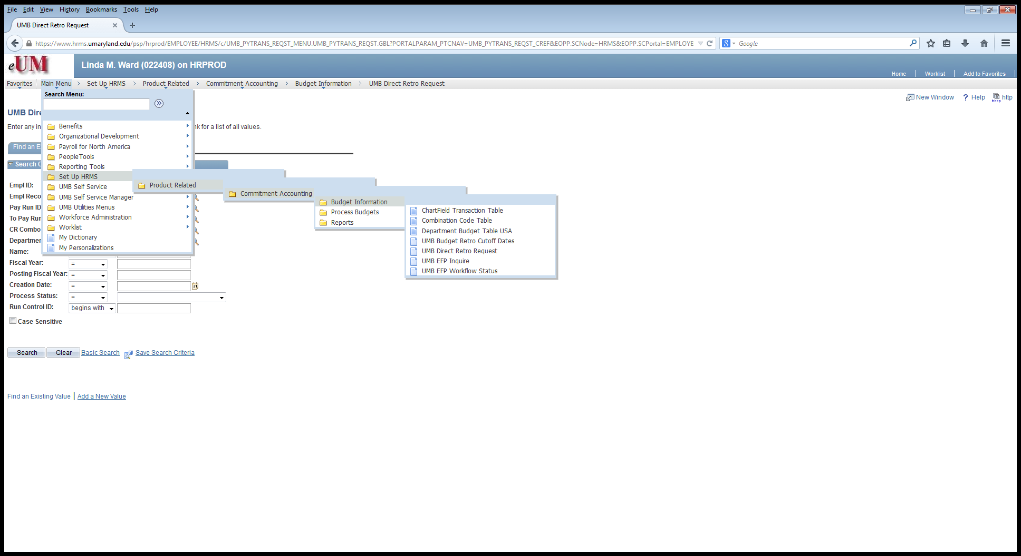
Direct Retro Search - Path
Finding a Direct Retro in HRMS
Breadcrumbs:
Set Up HRMS >> Product Related >> Commitment Accounting >> Budget Information >> UMB Direct Retro Request

Slide 22
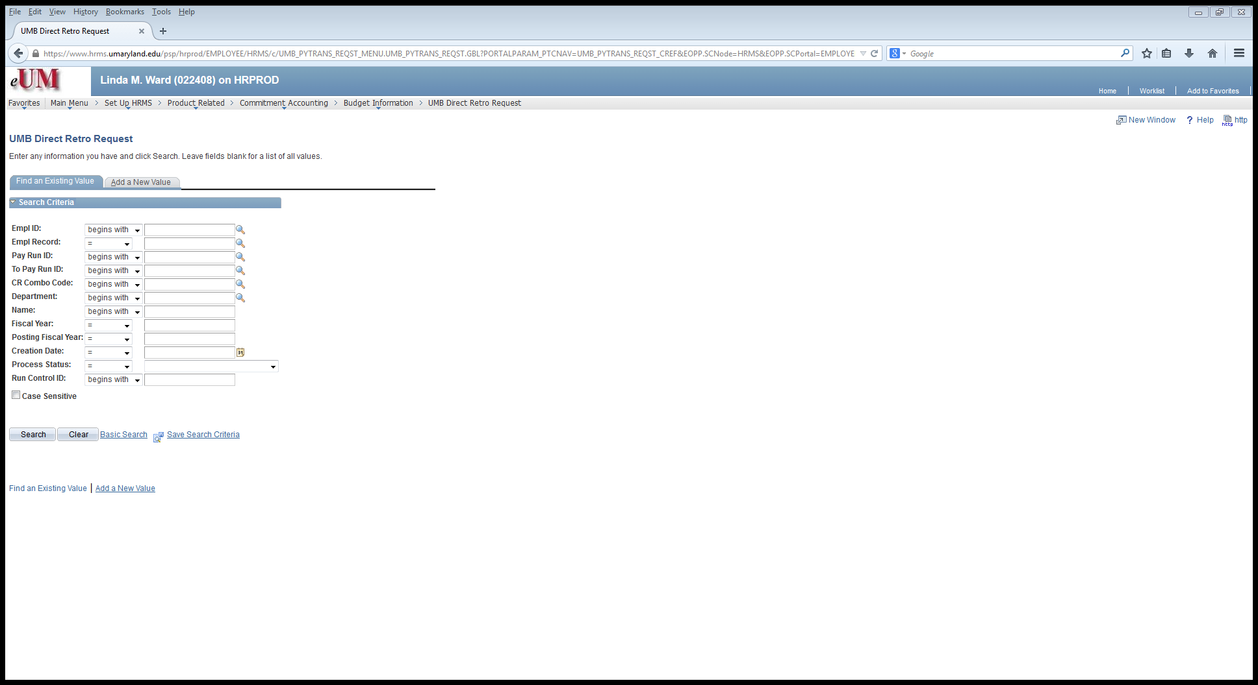
Direct Retro Search Criteria
Find an Existing Value
(Add function only available to Costing & Compliance)

Slide 23
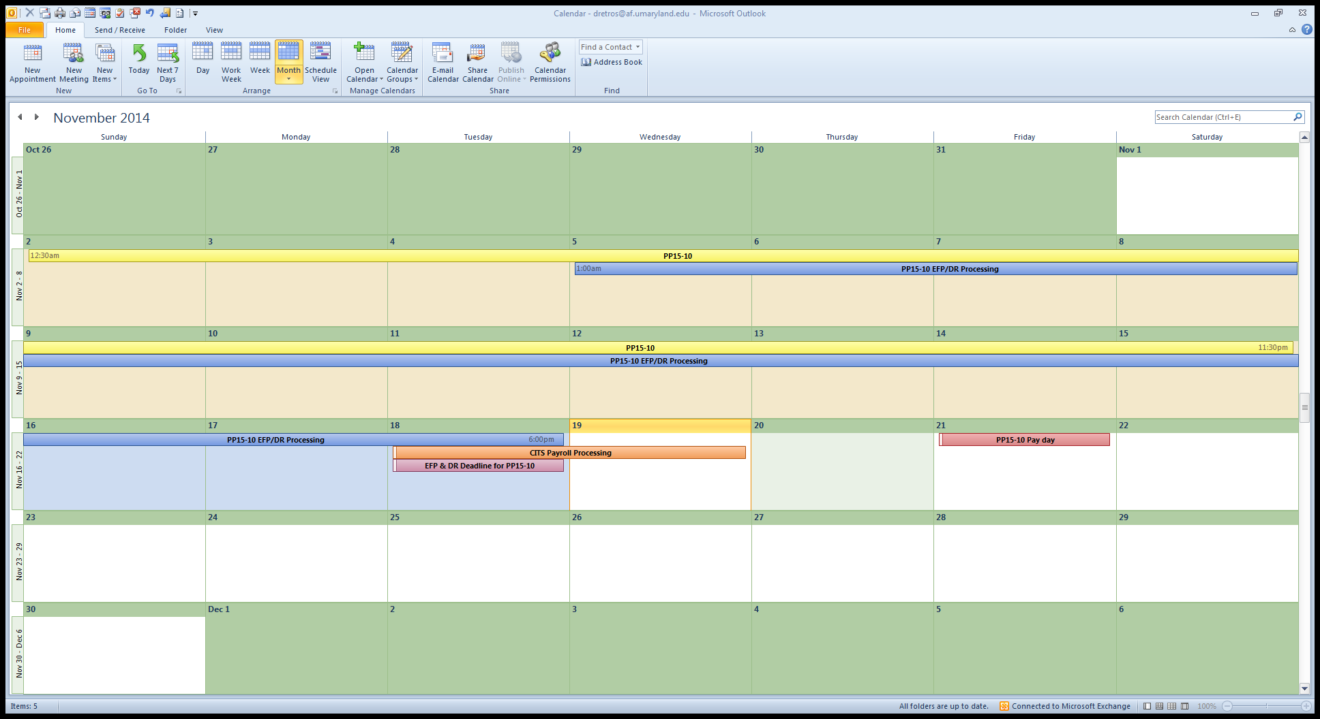
Direct Retro timeline
Yellow = pay period
Blue = EFP/DR cycle
Purple = EFP/DR deadline
Orange = Actuals Distribution
Red = Payday, Payroll shows up in RAVEN

Slide 24
Deposit Procedures
Email was sent to the RAC and FBO list serv
Checks are to go to the Cashier’s Office, not the 13th floor of the Saratoga building
New form
  http://www.fincsvc.umaryland.edu/images/FSF-560.pdf
Copies of the check and any supporting documentation must accompany the form
Encourage your sponsors to follow their award agreement and send payments to the lockbox

Slide 25
Columbia $9M Settlement
Related to their PEPFAR program – New York Based Salaries
Investigation conducted by the New York States Attorney and the DHHS Office of Inspector General
Columbia admitted that:
  They failed to use a suitable means of verifying whether the salary and wage charges that were applied to specific federal grants were based on an employee’s actual effort for that grant
  Certain effort reports contained inaccurate information, and for a number of years Columbia mischarged certain federal grants for work that was not allocable to those agreements

Slide 26
Columbia $9M Settlement – The Findings
Columbia had standard effort reporting policies, procedures and systems
The effort forms in question were all certified by the Principal Investigator
Employee stated that he spent approximately 15-20% of his time on the award in fiscal year 2010, but his effort report falsely listed his effort, and related salary charges on the award, as 85%
Employee performing similar activities for multiple grants were charged 100% to one of the grants
The department also charged federal grants for time spent on activities that are not chargeable to any federal grants, such as competitive grant proposal writing

Slide 27
Link to the DOJ Press Release
http://www.justice.gov/usao/nys/pressreleases/October14/ColumbiaICAPsettlementPR.php​

Slide 28
UMB’s Effort Policy
Certification should be performed by an individual with first-hand knowledge of 100% of the employee’s total effort.
For UMB this means that each person working on sponsored programs should certify his or her own effort reports, regardless of the person’s position.
  Faculty members are required to certify their own effort reports.
  If it is not possible for research staff member (e.g., graduate students, post doctoral fellows, technicians) to certify his or her own effort reports (e.g., due to involvement on several similar research endeavors), then
    the faculty member should certify the effort reports of the research staff working on his or her sponsored projects, or
    the effort form should be certified by the immediate supervisor of the research staff member
    Department administrators cannot certify the effort of faculty members or research staff.

Slide 29
UMB’s Effort Certification Statement
I certify that this report reasonably reflects the activities for which I, or the employee named on this report, was compensated by the University of Maryland, Baltimore [and, if applicable to me as a member of the faculty of the School of Medicine, by the faculty practice plan for the School] for the period covered by this report. I certify that I have firsthand knowledge or other suitable means of verification that the work was performed as certified.

Slide 30
Status of Uniform Guidance Implementation
Actions yet to be taken by the Feds
  Publish a final version of the Uniform Guidance with “technical corrections”
    Sometime before 12/26/2014
  Release agency implementations
    E.g. NIH Grants Policy Statement
    Sometime soon after 12/26/2014
  Standard Research Terms and Conditions
    Spring 2015???

Slide 31
SPA Personnel Changes
Amanda Snyder, Joan Kanner and Leerin Shields have resigned.
Red, Yellow and White teams will continue
In January, SPA will be reorganizing personnel within the teams. The announcement will come out in mid-December.
A major change will be in the creation of separate grant and contract roles within each team.

Slide 32
Coeus Reminders –
Viewing and Printing Grants.gov Forms
Go to the S2S tab
Click on forms marked “Yes”
Select print
This will print out all forms and attachments that are included.

Slide 33
Kuali Coeus Issues
There are currently 59 known issues within Kuali Coeus.
None of them will stop a proposal from being routed or stop a S2S
These issues will be published on the SPA Kuali Coeus website. Each issue will provide comments, resolutions and the priority of each issue.

Slide 34

Questions?

