Slide 1
SPA/SPAC Updates
3rd Quarter 2018
May 9, 2018
1:30 to 3:00 pm

Slide 2
SPA’s Agenda
Personnel Changes
Kuali Research

Slide 3
SPA Personnel Changes
Adrianna Dunnock
  Team White (Grants)

Slide 4
Kuali Research
Went live 5/1/18!
New Info & Guides on SPA website
  http://www.umaryland.edu/kualicoeus/user-resources-and-help/
KR team is looking at award and negotiation modules
Limited KR training dates through May
New user trainings will begin in June

Slide 5
New Routing in Kuali Research
Principal Investigator reviews proposal and answers certification questions
Proposal creator submits proposal into routing
If lead unit is I/C or Division, Department Administrator and Chair will receive an email informing them of a proposal in routing, NO approval needed
Dean’s office reviews and approves
SPA reviews and approves
Proposal is started and completed by Proposal Creator, cannot submit until PI certifies proposal
Lead Unit Administrator reviews and approvals proposal
Lead Unit Chair/Director/Chief reviews and approves proposal

Slide 6
PI Certification
Each PI must certify their proposal
FYI Notifications
Proxy certifications are done by SPA on case by case basis
  Certification questions must be answered by the PI via email and sent to SPA
  SPA will complete the certification only after the email is received

Slide 7
KR Subaward Budget Forms
4 new versions
KR proposal must be linked to FOA
S2S form must match Subaward Budget form
Send the correct forms to your subs

Slide 8
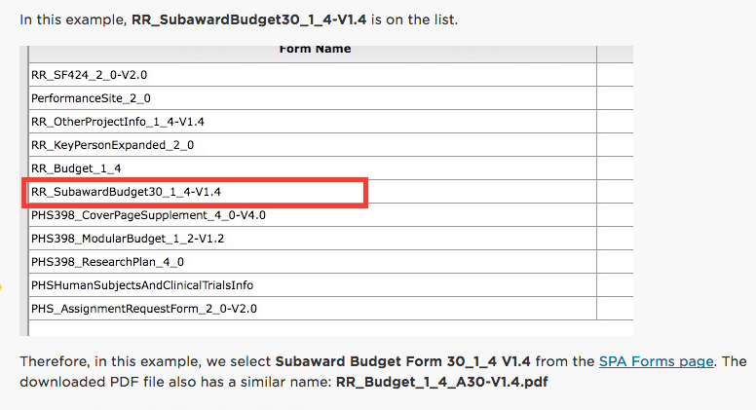
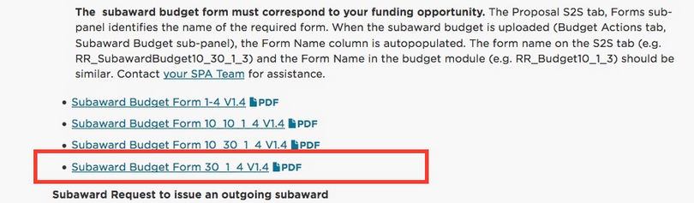

Slide 9
FDP
Incrementally Estimated Total
  New = Estimated (total period of performance)
  Mod/continuation = Cumulative (to date including current amount requested)
Estimated Project Period
Subrecipient Commitment Form
  1 page form for FDP schools
  3 page form for all others
FDP Push Back
  See SPA website https://www.umaryland.edu/spa/collaborations-and-subrecipients/proposals-with-subrecipients/fdp-pilot-pushback-sample/
Notes:
Total Amount of the Federal Award committed to the subrecipient by the pass-through entity as stated in the UG is a required field, and indicates the amount planned to be issued to a subrecipient in the future.

Slide 10
KR Proposals Reminders
Proposals created the same day will not show on SPA’s deadline report (internal)
Subrecipient Commitment Form is still a requirement at the time of proposal
Proposals with human subjects
  Complete billing analysis with CCT and UMMS
June 5, 2018 deadline

Slide 11
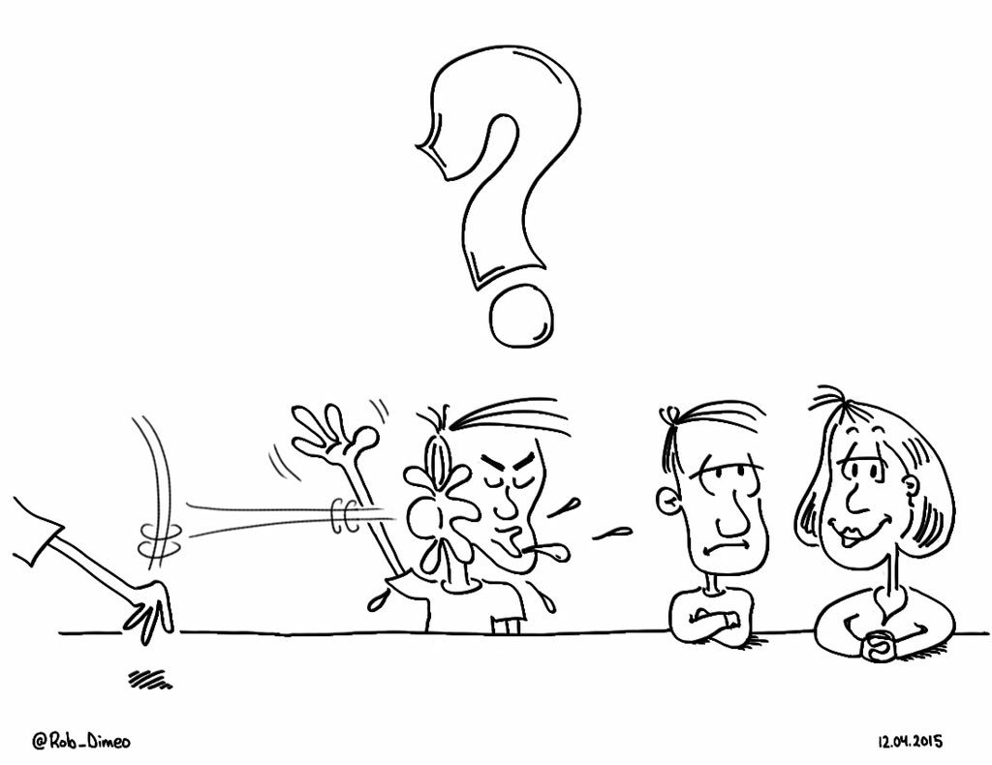
Questions?

Slide 12
SPAC’s Agenda
Staffing Updates
MPT update
VA Invoicing
Lockbox
Audits and Reviews
Reminders and New Stuff
  Year End SCR Reporting
  Closure Meetings Legislative Auditors
  New DIRRF New Emails for SPAC

Slide 13
SPAC Staffing Updates
Mila O'Callaghan– Team White Manager
Christina Tabb - Accountant 1 Cost Team
OPEN POSITIONS
Financial Accountant – Close
Manager, Central Team – Close

Slide 14
SPAC Staffing Updates
COST | CENTRAL
Beryl Gwan Sr. Manager Binita Shah Cost Accountant Amy Sallese Pt Cost Accountant Christina Tabb Accountant 1 | VACANT Manger Mary Miller Accountant Colin Fleming Accountant 1 Neda Karimi Accountant 1 Marcelle Finyom Accountant 1 Neli Georgieva Financial Acct VACANT Financial Acct

Slide 15
SPAC Staffing Updates
KRISTA SALSBERG, SENIOR MANAGER
TEAM RED | TEAM WHITE
Ron Hill
Financial Accountant Analyst
Brenda Hester
Accountant

Slide 16
SPAC Staffing Updates
WHITE TEAM | RED TEAM
Mila O’Callaghan Manager Krissy Long Financial Accountant Analyst Tammira Barnes Financial Accountant Analyst Claude Street Accountant 1 | Cheryl Williams-Smith Manager Shernett Wynter Financial Accountant Analyst David Addy Financial Accountant Analyst AJ Singh Financial Accountant Analyst Jean Indrova Gonzales Accountant 1
Chris Hook Accountant 1

Slide 17
MPT Update
Micro purchase Definition. As defined in the FAR at 2.101, a micro-purchase is an acquisition of supplies or services using simplified acquisition procedures, the aggregate amount of which does not exceed the micro-purchase threshold.
https://quizlet.com/187983169/simple-acquisitions-procedures-flash-cards/

Slide 18
MPT Update
Implementation of the Uniform Guidance Procurement Standards, 2 CFR 200.317-326, to become effective on the first day of our new fiscal year.
For the first version of UG, the MPT was $3,500. However, Congress recently passed a statute into law, changing the definition of MPT from $3,500 to $10,000.

Slide 19
MPT Update
This revision has not been codified in the Uniform Guidance yet
Feds are issuing a clarification memo
This will negate any audit findings during the update period to align the new threshold with UG with the FAR

Slide 20
On December 12, 2017, the 2018 National Defense Authorization Act (NDAA) was signed into law. Title VIII of the NDAA contains many provisions designed to reduce burdensome regulation and improve the procurement process. Section 805, 806, and 811 would increase:
Micro-Purchase Threshold (MPT) from $3,500 to $10,000
Simplified Acquisition Threshold (SAT) from $150,000 to $250,000
Truthful Cost or Pricing Data (aka “TINA”) threshold from $750,000 to $2,000,000
The Cost Accounting Standards (CAS) threshold for contract awards would also increase to $2,000,000 since it is tied to the TINA threshold…..

Slide 21
Type of Acquisition | UMB | FEDERAL GOVERNMENT
MICO-PURCHASE THRESHOLD | LT $5 K No bidding Use P card | LT 10K Set by NDAA Not codified in UG Yet Issuing Clarification Memo (audits)
SIMPLIFIED ACUISITION | GT 5K AND LT 25K Competition preferred NR Comparative Pricing At least 2 sources | GT 10K – LT 250K Set by NDAA Fixed Price Subcontracts Easier & faster to Negotiate This is referenced in the Uniform Guidance
Full Competition | GT 25K TO 200K COMPETITION BIDDING PROCESS | GT 250K Sealed Bidding Negotiated Procurement

Slide 22
VA Invoicing Update
SPAC has discovered that we are unable to bill the VA without a PO# or a current PO#
Their PO #’s expire at the end of their FY 9/30
SPA is not accepting awards without PO #’s assigned
Even if assigned – if we bill past 9/30 – need new PO
Working on an updated process

Slide 23
Lockbox Update
Several Months ago, we changed Lockbox providers
Lockbox address remained the same EXCEPT…
Expedited payments:
  Lockbox Services Box # 41428
  University of Maryland, Baltimore
  7175 Columbia Gateway
  Columbia, MD 21046 Even if assigned – if we bill past 9/30 – need new PO
https://www.umaryland.edu/spac/sponsored-projects-accounting-and-compliance-spac/about-the-office/spac-banking-information/

Slide 24
Audits and Reviews
A133 SINGLE AUDIT
5 SOM Departments
Look for programs over the $2M Threshold per year
Large number of programs in the University
No findings from the auditors
NSF DESK REVIEW
DOJ DESK REVIEW
HOUSEKEEPING

Slide 25


REMINDERS AND NEW STUFF

Slide 26
What is coming!
Year End
  meeting next week to define all of SPAC dates
Closure meetings
  Defining lists of projects for departments
  Setting up meetings to discuss action plans for closure
  Some older items will be discusses at the school level rather than department level

Slide 27
What is Coming
New DIRRF
  Easier to use
  Auto fills many of the fields
  Will automatically create the invoice on SPAC side
SCR Reporting
  Due in October, but we start the process in July
  For Federal Service Contracts Only
  Will be notified by Esther Ndiangui from our office
Legislative Auditors are back in SPAC at the end of June

Slide 28
What is coming!
New Emails for SPAC
  SPAC_ACT
    Actions for Customer Service & Training
    Taking ideas for SPA/SPAC meetings, brown bags and customer service improvements
    Suggestion box that will be monitored by our ADMIN
    Not a complaint box – they still go to the management
  SPAC_CS_FUND_Assignment
    For notifying SPAC of a change in a department CS fund

Slide 29

Questions

Slide 30
Costing and Compliance Updates

Slide 31
SPAC/COST Agenda
Staff Updates
Fringe Rates
Processing Reminders
NIH Salary Cap
Taxable Travel and the new Procedure

Slide 32
Costing and Compliance Team Updates
Beryl Gwan
  Manager, Costing & Compliance
Binita Shah
  Cost Accountant
Sallese Amy
  Cost Accountant
Christina Tabb
  Accountant 1, Effective 03/05/18

Slide 33
FY19 Fringe Rates
The FY19 fringe rates will be applied to the entire first pay period period in FY19
  PP19-01 (6/24/18 to 7/07/18)
The fringe for PP19-01 will be posted as follows:
  6/24/18 to 6/30/18 – Posted to FY18
  7/1/18 to 7/7/18 – Posted to FY19

Slide 34
FY19 Fringe Rates Summary Chart
Pay Period | Rate Used | Posted in FY
18-26 | FY18 | 2018
19-01 | FY19 | 2018 (6/24-6/30) 2019 (7/1-7/7)
19-02 | FY19 | 2019

Slide 35
FY19 Retroactive Distributions
DEADLINE to submit Direct Retros to be posted in FY18 is Monday, 7/2/18
  From Tuesday July 03 – July 10 processing date, we will still be post to FY18. Depending on the volume we receive, your DR might post to FY18 OR FY19 is submitted after 07/02/18
All Direct Retros received from Wednesday 7/11/18 and forward will be posted to FY19
The direct retro cut off date for the 17-26 pay period is Friday, 6/22/18, by 2pm.
  Note that this is different from the usual Tuesday prior to the payday deadline to allow Costing and Compliance enough time to process the anticipated fiscal year end increased volume.

Slide 36
Direct Retro Cut Off Dates
When Received by Cost Analysis | Pay Period Processed | Posted in FY (HRMS and Financials)
Tuesday, 06/12/18 by 2pm | 18-25 | 2018
Friday, 06/22/18 | 18-26 | 2018
Monday, 7/2/18 | 19-01 | 2018
Tuesday, 7/3/18 and beyond | 19-02 | 2019

Slide 37
DR Processing - Reminders
Physician Services Contracts Exception:
  No Direct Retros moving payroll to or from a PSC account in FY18 will be processed after the FY18 DR deadline on Monday 7/2/2018
A direct retro and a budget retro cannot be processed in same pay period
Plan accordingly!!!

Slide 38
Cost Sharing for Payroll Expenses
NIH Salary Cap was increased to $189,600 effective 1/7/2018. Check employees who may go over the cap with 7/1 pay changes
  Amount is based on annualized salary- Ex. FTE=.20 and amount paid at UMB= $40K → Annualized= $200K
This only applies to NIH agencies- if you don’t know whether a sponsor is under the NIH umbrella check the following website: http://www.nih.gov/icd/index.html
Position owner creates EFP but may be unaware that a project from another department requires Over The Cap - communicate!

Slide 39
New Salary Cap Continued
Notice posted to link below
  https://grants.nih.gov/grants/guide/notice-files/NOT-OD-18-137.html
New Proposals
  Use new salary cap for budgeting
Active awards
  You CAN rebudget if funds are available
  But no additional budget will be provided

Slide 40
New Taxable Travel Policy
The new policy and its related procedure VIII-11.00(A)- UMB Policy and Procedures on Business Travel For UMB Employees and Nonemployees were approved effective 1/1/18
The new policy introduces 2 types of transactions that are taxable:
  Day Business Travel Meals
  60-day rule for travel expense forms submitted more than 60 days after the return date

Slide 41
Taxable Travel - Income
Taxable travel transactions are considered as taxable earnings to employees and will be sent to CPB as taxable income, not reimbursements. Both employees and employer will be taxed

Slide 42
Taxable Travel Expense and Penalty
Taxable Travel Expense is allowable on grants
  Account 3330 (Instate travel taxable)
  Account 3331 (Out-Of-State travel taxable)
  Account 3332 (Foreign travel taxable)
  Expense Will be posted to PCD
  Can only be moved via Direct Retro
BUT punitive fringe expense is NOT allowable
  It’s a penalty
  Fringe posted to 2798 (Fringe rate tax Late travel)
  Posted via journal entry
  Calculated Fringe rate 8.4%
  Will not show up on PCD

Slide 43
Day Business Travel Meals
Day Business Travel Meals are allowable on grants
  Account 3371 Day Business Travel Meals
  Expense Will be posted to PCD
  Can only be moved via Direct Retro
Related fringe expense is also allowable
  Fringe posted to 2797 (Fringe rate tax Day Travel Meal)
  Fringe will be automatically calculated in HRMS
  Legislated Benefit Fringe rate of 8.4% will be applied
  Fringe Expense Will be posted to PCD

Slide 44
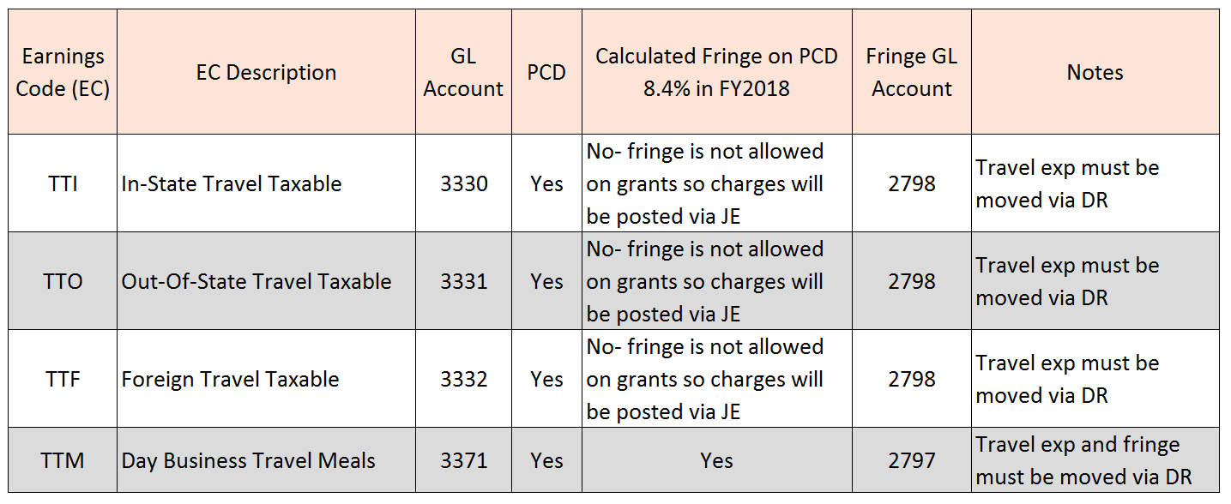
Taxable Travel, Summary

Slide 45
Direct Retro (DR) for New Policy
Direct Retro Form has been updated with new account codes
Other DR guidelines remain unchanged. See link below:
  http://www.umaryland.edu/media/umb/af/cost/eUMB_Direct_Retro_form_FY13_forward.xlsx

Slide 46
Questions

Slide 47
Final Notes
Both presentations will be available on SPA and SPAC websites
Thanks for joining us today!

