Slide 1
SPA/SPAC UPDATE MEETING
May 19, 2016
2:30 – 4 pm
Pharmacy Hall: N203 Lecture Hall

Slide 2
TODAY’S AGENDA
Financial Services Update
Revisions to the Study Participant Payments Procedure
Year End Updates
Financial Systems Update
SPA/SPAC Joint Updates
Reorganizations/Staffing Update
Recent State Agency Issues
Recent VA IPA Trainings and Enforcement
SPA Updates
Research Matters
eSuRF
Kuali Coeus
Reminders
SPAC Updates
Fringe Benefit Rate Update
Fair Labor Standards Act
Fixed EFP Changes
Reminders

Slide 3
Study Participant Payment Procedures
Updated to incorporate recent changes
Requirement to show 4862 activity on projects where cash or gift cards were previously expensed
Physical safeguarding of cash or giftcards
Lockboxes or safes with combination locks that can be changed when personnel changes
Limiting access to cash/GCs to 1 person but have multiple people with cash/GCs
Availability of Gift Card System (GCS)

Slide 4
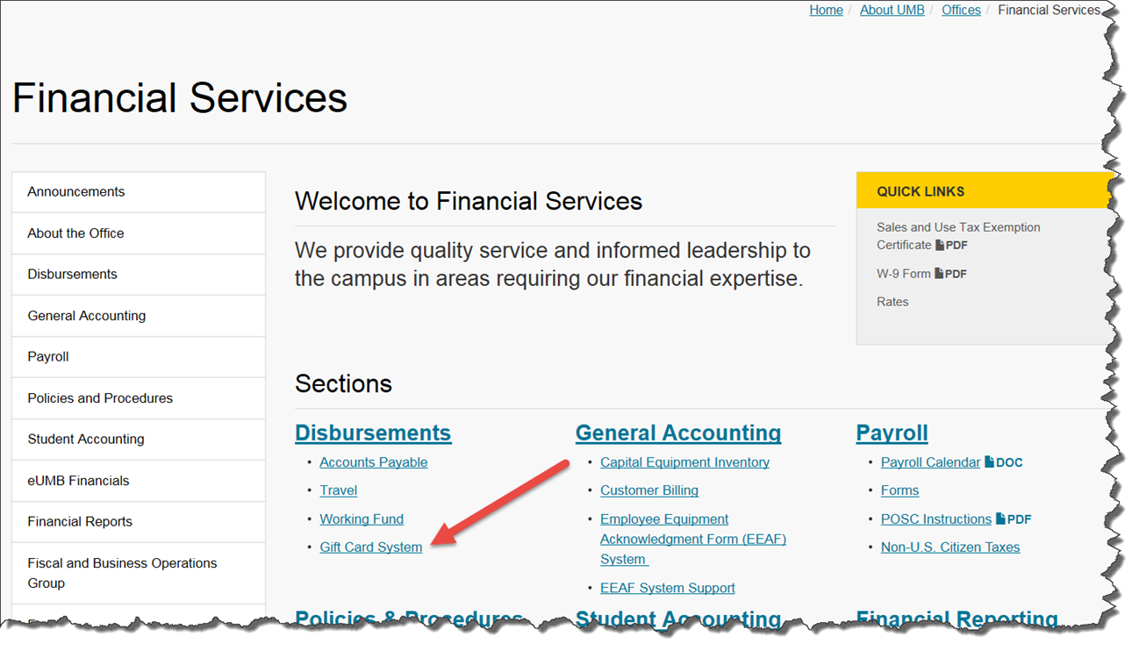
Study Participant Payment Procedures

Slide 5
FY16 Year End deadlines
FY16 PUR01 requisitions will not be approved after tomorrow (5/20)- they will be recycled with instructions to submit as a FY17 requisition
FY16 PUR02 requisitions will not be approved after Wednesday, June 8th
If you have an emergency FY16 procurement you must contact Joe Evans and he will instruct Fin Services as to whether we can approve it

Slide 6
eUMB Financials Replacement Project

Slide 7
Why ?
eUMB Financials/RAVEN – live since 3/23/06
Upgraded/Modified/ Enhanced/Customized the System to support our ever evolving needs – cost sharing, new FB model, Project Year to Date Salary Encumbrance to name a few
Times are changing…
Market data indicates a move to new computing models
Mobile workforce pressures
Cost/Budget constraints
The need for better, more timely information

Slide 8
Why?
The four too’s – Big, Slow, Complex, Expensive
All on-premise ERP provides are de-investing in product develop
The rent vs. buy movement is the new model
Cloud computing is now 1st choice for most institutions
Costs – capital to operating

Slide 9
Project Target Timeline
FY 2016
May 1
Jun 30
Award Contract
IT Consulting for Req. Analysis
Gather Requirements..
FY 2017
Aug
Sept
Oct
Nov
Dec
Jan 2017
Jul 2016
Jun 2017
Gather Requirements…
Issue RFP/Evaluate Responses/Make Award/Contracting
Start Implementation of Cloud Finance Deployment
Phase 0 implementation planning, assemble teams,
finalize scope, approach and conversion strategies etc
FY 2018
Jul 2017
Jan 2018
Jun 2018
Continue Cloud Finance Deployment…
Go -Live

Slide 10
SPA/SPAC Updates 2nd Quarter 2016
May 19, 2016
2:30 – 4:00 pm

Slide 11
SPA Personnel
2 open positions – Manager and Sr Administrator. Currently interviewing, in place by 7/1/2016
Danielle Brown is currently managing both Team White and Yellow.

Slide 12
SPAC New Staff
Esther Ndiangui, Sr. Contracts Accountant
Andrew Rice, FA Team White
Larcell Pannell, FA Team Yellow
Nur Syeda - Intern

Slide 13
SPA/SPAC School/department assignment change
As of July 1, 2016 – SPA and SPAC will be making changes to the School/Department Assignments.
Team Yellow will be eliminated

Slide 14
New Assignments

Slide 15
SPAC ORGANIZATION CHART
Effective 07/01/2016
Krista Salsberg
Team White Manager
Andrew Rice
Financial Accountant
Amy LaFevers
Assistant Director
Ron Hill
Financial Accountant
Shernett Wynter Financial Accountant
Karen Little Accounting Analyst
Brenda Hester Accountant
Cheryl Williams-Smith Financial/Closeout Accountant
Victoire Bikoi
Financial Accountant
Laura Scarantino
Director
Michelle Moore
Red Manager
Mary Miller
Collections, Accountant
VACANT
Financial Accountant
Tammira Barnes
Accountant I
Start Date 5/31/16
Kathleen Wiess
Sr. Manager
Accountant I - Vacant
Accountant I - Vacant
Esther Ndiangui
Sr Contract and Grant Financial Accountant
Larcell Parnell
Financial Accountant
Christian Onwudiegwu Financial Accountant

Slide 16
State Agency Issues
Potential Legislative Audit Finding
Concern that State Agencies are using Interagency Agreements to circumvent procurement regulations
Make sure we are actively participating in vendor agreements for services and subcontracts

Slide 17
State Agency Issues – DBM Approval
Effective 7/1/2016
All new state agency agreements will need approval from DBM
In FY 2016, it was just awards over $500,000
All on-going agreements over $500,000 will have to be reviewed every year by DBM

Slide 18
Update on VA IPAs & Contracts
Presented by: Bryan Soronson MPA, CRA, FACMPE

Slide 19
VA IPA Training Highlights
IPA Training was conducted to the community on 4/4/16 from Pamela Zgorski, VA Maryland Health Care System HR Contact
PowerPoint slides and information sent to those in attendance, communications continue to follow
Major Change: no post-doctoral fellows are permitted on IPAs
Those currently in process are being denied
Those with fully executed IPAs are to terminate early
A few VA IPA training highlights:
Must enter all dates of previous IPA’s (use separate page if necessary)
Salary/Rate in box 14 (state salary), box 23 (rate of pay), & box 26 base salary (federal agency obligations) must match
Box 21 (Reason for Mobility Assignment) must provide specific explanations answering all questions

Slide 20
VA IPA Training Highlights continue…
Box 22 (Position Description):
list major duties and responsibilities to be performed
administrative and support duties should not be listed
New: the following must be included in all IPA’s for the employee:
Tour of duty (days and hours employee will work)
Location of work (building, department, and room)
“Employee is responsible for hours of duty and for notification to supervisor of any inability to be present for work.”

Slide 21
VA IPA Training Highlights continue….
Fiscal obligations, box 26: follow specific cost breakdown, see below example:
Year 1 Fraction (Assign. Months/12): .83 (10 months)
Base Salary: $23,000
FTEE (60% Effort): .60
Assignment Salary: $16,000
Fringe Rate: 41.8%
Fringe Cost: $6,688
Year 1 Total VA Obligation: $22,688

Slide 22
VA IPA Lead Times & Suggestions
According to Carol Roberts, Administrative Officer, Office of Research & Development (Research Service), Baltimore VA Medical Center, partially executed paperwork needed at VA Research Service at least 60 days in advance of desired employee’s start date;
VA HR (Perry Point) requires the paperwork in their office at least 30 days prior to the employee’s desired start date
IPAs cannot start without the assigned employee’s approved Without Compensation Appointment (WOC)

Slide 23
VA IPA Temporary Project Ids
VA has stated that they will no longer be back dating IPAs
Going forward, all VA IPA temporary project id requests will require the physical signature of the Dean’s Office

Slide 24
IPA Suggestions
Utilize VA direct hire mechanism for new employees who are slated for 100% on an IPA
IPA off campus F&A rate is 7.8% for FY16+
UMB will start discussions about adding this to IPAs
VA Handbook states that overhead not allowable to be added for VA IPAs. Will they enforce this?

Slide 25
VA Contracts
Two types of VA contracts recommended from Carol Roberts:
Personnel Services Contract
Consulting Services Contract
Lead time for processing VA contracts is at least 90 days
Contracts will be submitted with our negotiated rate
26% for off-campus awards

Slide 26
VA Contacts
Pamela Zgorski, Program Specialist HRMS, VA Maryland Health Care System 410-642-2411 ext. 5201, pamela.Zgorski@va.gov.
Carol Roberts, Administrative Officer, VA Research and Development, Baltimore VA Medical Center, 410-605-7000 ext. 6706, carol.roberts3@va.gov.

Slide 27
Questions?

Slide 28
SPA Updates 2nd Quarter 2016
May 19, 2016
2:30 – 4:00 pm

Slide 29
Research Matters
A new forum that will allow all UMB personnel to search for answers to their questions and/or receive an answer to a question that has never been asked before.

Slide 30
eSuRF
eSuRF will be shutting down on June 1, 2016.
Campus will be required to use the electronic Subaward Request Form.
Scope of Work and Budgets will be required for all actions.
Subaward Request form can be accessed at SPA’s website under SPA forms.
We are also now providing a Subaward Budget template form.

Slide 31
Kuali Coeus
NIH Form Set D should be put into production this weekend (5/21/2016). Unless problems arise.
Proposals that involve other Schools or Department personnel:
Provide View Access to the Administrator and Dean’s office for the Key Person; or
Require routing of all Key Personnel; or
Require a new DRIF form to be used.

Slide 32
Reminders
When routing proposals that have corporate sponsors, there are only four choices for activity type
Corporate Research - CME Corporate
Corporate Clinical Trial -Corporate Other Activities
Please, please use the Team Emails when communicating with SPA, unless an action has been triaged and you know the SPA person that is working on that action.
You must use the Subrecipient Commitment Form if you have a subrecipient within your proposal. SPA staff have been given instructions to hold your proposal until the form is in KC.
Getting your Proposals in early

Slide 33
SPAC Updates 2nd Quarter 2016
May 19, 2016
2:30 – 4 pm
Pharmacy Hall: N203 Lecture Hall

Slide 34
FY 17 Fringe Benefit Rates
 | Apply to Accounts | FY16 Finalized | FY17+ Finalized | Fringe Account
Faculty | 1011 – Faculty 9/10 Month | 23.4% | 26.4% | 2790 - Fringe Rate Faculty
 | 1012 – Faculty 12 Month
Staff | 1013 – Exempt Staff | 35.1% | 40.9% | 2791 - Fringe Rate Staff
 | 1014 - Non-exempt Staff
Legislated Benefit | 2071 – Faculty | 8.4% | 8.5% | 2793 - Fringe Rate Legislated Benefit
 | 2072 - Exempt Staff (C1)
 | 2073 – Non-exempt Staff (C1)
 | 2074 - College Work Study (CWS) (Summer)
 | 2075 - Student (other than CWS) (Summer)
 | 2080 – Summer Salaries
 | 2110 – Overtime
 | 2120 – Shift Differential
 | 2130 - On-call Pay
Limited Benefit | 1021 - Post Docs/Fellows | 25.8% | 26.1% | 2792 – Fringe Rate Limited Benefit
 | 2090 - Contractual Employee (C2)

Slide 35
Fair Labor Standards Act (FLSA)
Long awaited new regulations published on Wednesday
Takes effect on December 1, 2016
Sets the overtime wage threshold at $47,476 per year
Graduate and undergraduate students who are engaged in research
Exempted from this new regulation because they are in an educational rather than an employment relationship
Graduate students whose primary duty is teaching or serving as teaching assistants
Exempted under the teaching exemption

Slide 36
FLSA and Post Docs
Post Docs were not exempted from the regulation
New threshold is above the first three levels of the NIH NRSA post doc minimums
NIH responded by saying that they were going to increase these minimums so that all were above the new threshold

Slide 37
Fixed EFP Changes
Fixed EFPs are the Employee Funding Profiles in HRMS used when a retroactive pay is effective for pay periods in the prior fiscal year(s)
More to be covered in the Commit Accounting Rollover meeting
June 2nd, 9:00 SON Rm. 140

Slide 38
Fixed EFP Changes
Exempt Employees
No Fix EFPs
All prior year retropays will fall to the PCA
Non Exempt and Hourly
Fixed EFPs for 4 pay periods of previous fiscal year to accommodate retropays resulting from timesheet completion
Retropays going back more than 4 pay periods will fall to PCA

Slide 39
SPAC Reminders
March effort forms are due Tuesday, May 24th

Slide 40
Final Notes
Presentation will be available on SPA and SPAC websites
Thanks for joining us today!

Slide 41

Questions?

